Slide 1
Trainees training others
Your name
Date
Funder: Canada Post Mental Health Foundation
Drug Evaluation Alliance of Nova Scotia
Collaborator: Schizophrenia Society of Nova Scotia
Notes:
This slide set is for the exclusive use of pharmacists who have completed the More Than Meds program training. This training is offered by the project team and by those who have been trained directly by the project team (i.e., the trained trainers). For more information, contact david.gardner@dal.ca. © Andrea Murphy and David Gardner, All rights reserved.

Slide 2
What we’re going to discuss:
0:00 | XXXXX
0:00 | YYYYYYY

Slide 3
Why are we here?

Slide 4
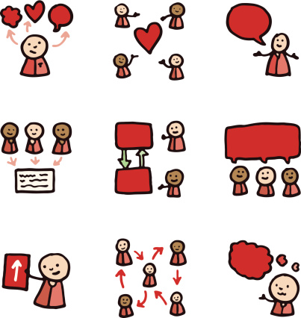
Notes:
This is a project about building capacity a network of pharmacists and people with lived experience of mental illness in Nova Scotia who will support each other and people with lived experience of mental illness (or their friends and family members) in their community. Pharmacists can provide “More than Meds” and help people to think about services in their community through a “navigator” role. Pharmacists can also do outreach in their communities such as in the form of an education session via a family support group that happens in their community. These outreach or education sessions do not always have to be about psychotropic medications. People with lived experience of mental illness often experience poorer health outcomes (e.g., cardiovascular events, morbidity, mortality, number and kinds of preventative and intervention tests) from what international literature has shown. With that in mind, we encourage pharmacists to also consider to educational outreach on physical health as well as mental health conditions. Other general topics about medications may also be very helpful. For example, having a session on medication interactions with over the counter products could be very useful.

Slide 5
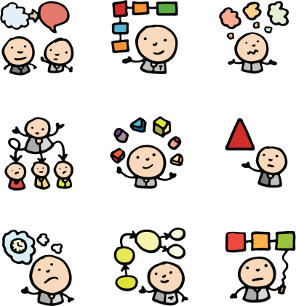
Personal Stories
Notes:
When training trainees, using your personal stories of experiences in the pharmacy setting are often helpful to discuss issues. When sharing stories please keep confidentiality and respect in mind. It is certainly not required that you share stories as you discuss the principles and ideas around this content.

Slide 6
Training Expectations & Outcomes
As an individual, you are knowledgeable, capable, and experienced.
TOGETHER through training and discussions, we can motivate, educate, and identify opportunities to advance mental health competencies. We will form a network in our province. Our trainees will train 5 other pharmacists and a back up pair. YOU are one of those trainees!! Welcome!!
Pharmacist trainees will engage in their communities by providing outreach education and potentially more coordinated support for people with lived experience of mental illness.
Notes:
This training relies on the fact that pharmacists are knowledgeable people who meet certain competencies and that people with lived experience of mental illness and pharmacists can have reciprocal learning from working together in this project. Pharmacists can go forward in their communities using the tools from www.morethanmeds.com and the support of the More than Meds team to support them in doing educational outreach and providing excellent care to their patients.

Slide 7
Project Objectives
Promote
Support
Improve
Collaboration
Relationships
Notes:
The ultimate goal is to support one another to create a network of individuals who work individually to support people with mental illness in their communities but that we also share in a collective experience and drawing from each other’s shared experiences.

Slide 8
Project Objectives
Engage
Empower
Mobilize
Notes:
This project is as much about engage pharmacists and people with lived experience in working together as it is about improving outcomes. We see working together as a mechanism to work towards improving outcomes.

Slide 9
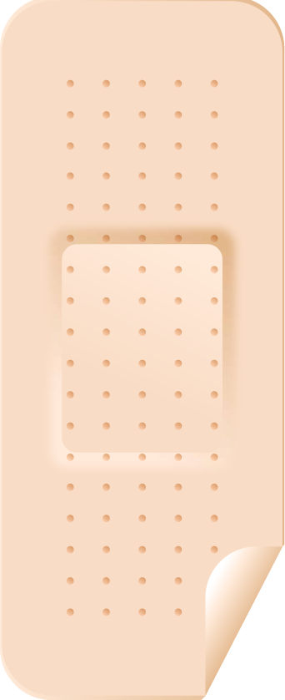
Project Objectives
Effective
&
Efficient
Services
Notes:
Ultimately it would be extremely valuable to make differences via helping people to receive efficient and effective services. These kinds of outcomes do not happen overnight. Sometimes it is also just as important to know the lessons learned along the way to these outcomes versus just arriving at the outcome.

Slide 10
What we’re going to discuss:
0:00 | XXXXX
0:00 | YYYYYYY

Slide 11
What is the pharmacists’ role?
Notes:
Use this slide, or if you make a handout, you can use this time to discuss practice patterns and the kinds of things that you are your trainee currently offer for people with lived experience of mental illness. It might also work well to discuss the various opportunities and challenges you have in practice for various kinds of services.
Encourage your pharmacist trainees and others in attendance to speak openly about their experiences and concerns. Many will reflect on the barriers to “ideal patient care”. It is good to get these sentiments in the open and identify ways to improve our status quo without feeling we need to achieve an ideal.

Slide 12
Here’s what’s expected:
Notes:
The next section just reminds us of what some of our entry to practice competencies and similarly, our models standards of practice for Canadian Pharmacists.
For more information visit: http://napra.ca/Content_Files/Files/Model_Standards_of_Prac_for_Cdn_Pharm_March09_Final_b.pdf

Slide 13
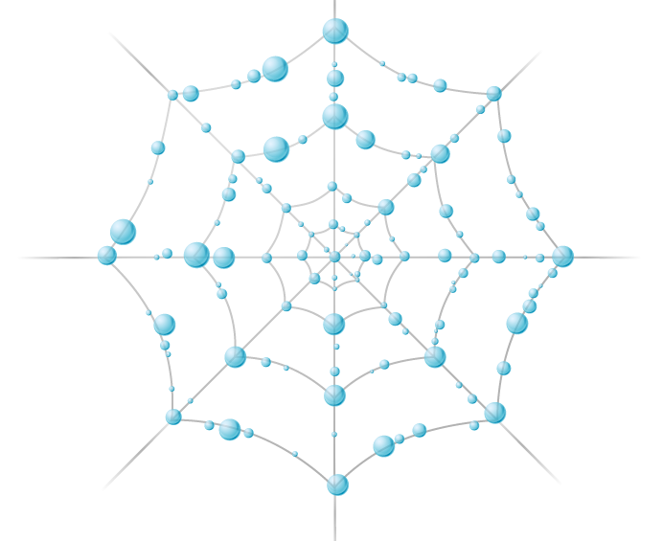
Advocate
Collaborator
Scholar
Communicator
Manager
Care-provider
Professional
Leader
Notes:
Here are some of the competencies in their categories.

Slide 14
Internationally
Notes:
Australia is a country with research in this area and that has moved towards characterizing and defining mental health care competencies for pharmacists. The next four slides show this.

Slide 15
Pharmaceutical Society of Australia: Document update initiated in 2011 in cooperation with the Mental Health Council of Australia

Slide 16
Promote Optimal Use of Medicines
Participate in therapeutic decision making
Provide ongoing pharmaceutical management
Promote rational drug use
Patient history, review medication treatment, recommend Rx changes, support self-management, follow-up
Follow & initiate change, document and maintain records
Examine prescribed medicines in the context of medication history and current treatment

Slide 17
Provide Primary Health Care
Assess needs
Address primary health care needs
Promote good health in the community
Elicit clinical information, identify management options, initiate & work with others
Advise on non-medicinal treatments
Participate in public health strategies

Slide 18
Provide Health Education and Information
Develop and maintain information
Evaluate and synthesize information
Educate general public
Maintain information and resource reference base
Evidence-based/critical appraisal skills

Slide 19
Nova Scotia College of Pharmacists
Is what we are
describing
a fit with
Standards of
Practice?
Yes!
Notes:
We spoke with NSCP to see if educational outreach was part of our scope and it is.

Slide 20
The Future
Notes:
This program is not only good for our patients but an excellent opportunity to show others that we are moving our practice forward.

Slide 21
Let’s pair share
Tell us about what happens in a pharmacy?
What do pharmacists talk about?
What do pharmacists do well?
What could pharmacists do better?
What helps pharmacists do a good job?
What prevents them from doing a good job?
What are pharmacists’ roles?
What about other pharmacy staff members?
Notes:
Encourage your pharmacist trainees and others in attendance to speak openly about their experiences and concerns. Many will reflect on the barriers to “ideal patient care”. It is good to get these sentiments in the open and identify ways to improve our status quo without feeling we need to achieve an ideal.
This slide is an opportunity to discuss with your trainee about some of the challenges and opportunities you have in your practice. These will be evident for people and sometimes brainstorming about ideas and issues can help people.

Slide 22
Meet Mike. Here’s what his pharmacist does for him….
Asks about general health:
Nutrition
Exercise
Gives respect:
Warm greeting
Handshake/smile
Eye contact
Listens, responds, asks
Privacy
Asks about mental health:
Sleep
Focus/concentration
Worries
Mood/feelings
Thoughts
What could be better?
Asks about physical health:
Heart disease risk factors
Weight
Pain
Smoking
Allergies
What could be better?
Builds rapport:
Knows Mike’s ….
Likes & dislikes
Activities
Aspirations
Challenges
Family/friends
Job
Asks about medications
Rx, OTC, NHP, etc.
Adherence
Alcohol/other substances
What could be better?
Notes:
Pharmacist do many to all of these things daily. Let’s continue to bolster our efforts in asking about some small things about mental health that can make a big difference.
Often it is most helpful to speak with Mike and people like Mike about their physical health. Showing your genuine interest in Mike’s health overall and his interests promotes a strong pharmacist-patient relationship. Mental health issues can often be identified by starting with the question “How’s your sleep been of late?” This can be asked early or in follow-up discussions.

Slide 23
Some stories we know of…..

Slide 24
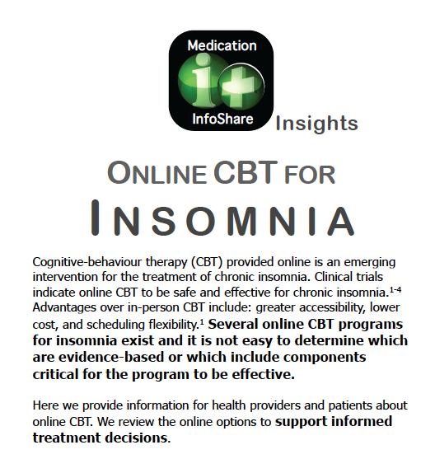
A middle aged woman with persistent insomnia is guided BY
HER PHARMACIST to an
effective online, evidence-based cognitive-behavioural therapy program for chronic insomnia. In 6 weeks she is having restful, revitalizing sleeps, the best she’s had in years.
She’s much less stressed and fatigued.
Notes:
Purpose of this example: to show pharmacist learners (and our patients) that we can help in ways other than giving medications. Often the pharmacist’s role is to help stop unnecessary or potentially harmful medications. Suggesting an effective alternative is important.

Slide 25
A mother of 2 young children demonstrated a
remarkable improve-ment in her depressive symptoms based on her pharmacist’s knowledge of the benefit of adding folic acid to her antidepressant therapy.
Her working husband was directly impacted.
Notes:
Purpose of this example: some interventions led by pharmacists are simple, evidence-based, safe, inexpensive, and easy to follow. With appropriate follow-up, pharmacists can determine the impact and the need for other suggestions.

Slide 26
A new immigrant woman with psychosis stabilized by her prescribed antipsychotic did not lose her job working as a university receptionist due to the advice of her pharmacist.
Noticing her severe medication-induced tremor she was embarrassed, avoiding certain task (typing) when others were around.
The pharmacist advised her physician of medication changes that not only resolved her tremor but also led to the return of her normal menstrual cycle.
Notes:
Purpose of this example:
Side effects can be missed or dismissed by the physician and can weigh heavily on a patient’s quality of life and decision to continue with treatment. Pharmacists have the knowledge to help but need to have a relationship with the patient and physician that promote these types of clinical activities.

Slide 27
During a medication review, a pharmacist uncovered that a 50 year old woman was
contemplating suicide due to a recent personal loss. The pharmacist helped her find a suitable counselor and she had her first grief counseling appointment within a week.
Notes:
Purpose of this example:
Pharmacists work with people in despair. This is not an uncommon experience for community pharmacists. Pharmacists need to know what to do. Being able to support a patient’s access to mental health services, even if just helping them make a phone call, can be critical to a person’s safety and wellness.

Slide 28
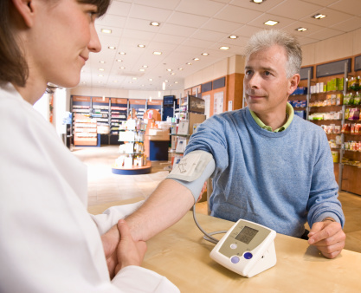
A 50 year old banker with bipolar disorder was found to have high blood pressure by using the pharmacy’s blood pressure machine. He had a psychiatrist but not a family doctor.
By working with his psychiatrist, the pharmacist was able to establish the diagnosis of essential hypertension and initiate standard therapy that was safe with his other
medications. With changes in his diet over time he has been able to control his blood pressure at a lower dose of his blood pressure medication.
He has also started smoking cessation therapy recommended by the pharmacist.
Notes:
Purpose of this example:
As elucidated in the next slide, pharmacists can play a pivotal role in the physical health of people with mental illness.

Slide 29
Pharmacists can address increased rates of physical causes of morbidity & mortality in people with Serious Mental Illness
Serious mental illness is associated with higher rates of common medical health problems, e.g., CHD, DM
Quality of health care is lower for people with serious mental health problems
CHD, DM, and other physical health outcomes are worse in people with SMI
Rates of appropriate medication therapy and adherence to them are lower in people with SMI
There is no health without mental health
Notes:
Research demonstrates that severe mental illness (schizophrenia, bipolar disorder, major depression) are all associated with increased rates of medical illness (CVD, diabetes, others) and increased rates of CV mortality. It also shows that these same patients tend to receive lower quality care overall and adherence can be poor. Pharmacists have a role to play with each of these issues.

Slide 30
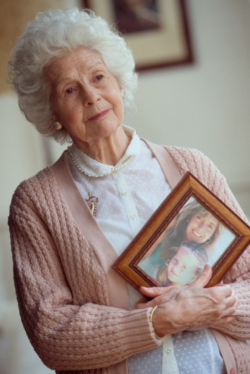
An elderly woman shyly admitted to her pharmacist about her recent falls. He noted she’d been on a long-acting sleeping pill for years. In working with her prescriber, the pharmacist guided the patient and her physician through a benzodiazepine withdrawal plan and provided her with sleep hygiene advice and resources. Six months later the woman was off her sleeping pill, sleeping well, and no longer falling.
Falls in the elderly are associated with fear, anxiety, withdrawal, reduced socialization and activity, in addition to the well know risk for fractures and disability. Psychotropic medications may account for more than 1/3 of hip fractures in the frail elderly!
Notes:
Purpose of this example:
The risk of psychotropic medications in the elderly is increased compared to younger users of the same medicines. This may tip the risk:benefit ratio unfavourably. A pharmacist with a good relationship with local prescribers can support reduced unnecessary use of these agents.

Slide 31
Your feedback …
Tell us your impressions of the previous section regarding pharmacists in caring for people with mental health problems.
Notes:
Encourage your pharmacist trainees and others in attendance to speak openly about their experiences and concerns. Many will reflect on the barriers to “ideal patient care”. It is good to get these sentiments in the open and identify ways to improve our status quo without feeling we need to achieve an ideal.

Slide 32
What we’re going to discuss:
0:00 | XXXXX
0:00 | YYYYYYY

Slide 33
Resources
Navigation/triage support
Online information
Pamphlets, booklets, etc.
HP Mental Health & Therapeutics
Notes:
The next section discusses some areas of resources that pharmacists will often want to use or use.
If you provided your trainees with a pre-training assignment that asked them to look online at various resources, for example different linked websites available on the More Than Meds resources webpage, the following slides would be where to discuss with them what they found.

Slide 34
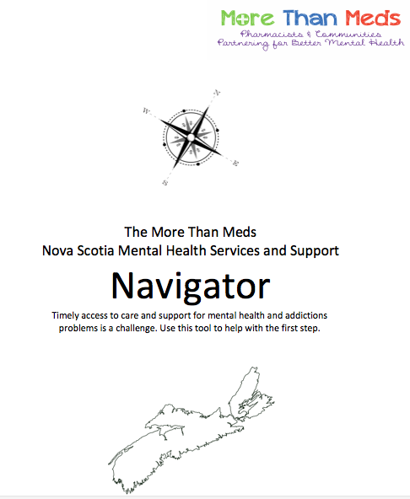
Navigational Support
Notes:
A tool for anyone and everyone in NS, but designed for pharmacists to use to help their patients access mental health services.
Patients will be surprised to see pharmacists with such a resource at hand and many will be relieved that someone is willing to listen and make an effort to help them reach out and find support.
The pharmacist does not need to feel like the expert in NS mental health services, but they can help the patient find those people who are.

Slide 35
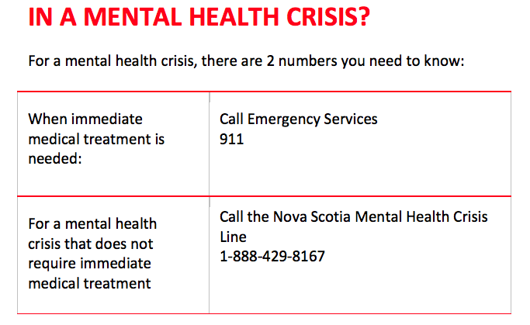
Notes:
Each trainee should have a navigator in hand and leaf through the first few pages to find this IMPORTANT page.

Slide 36
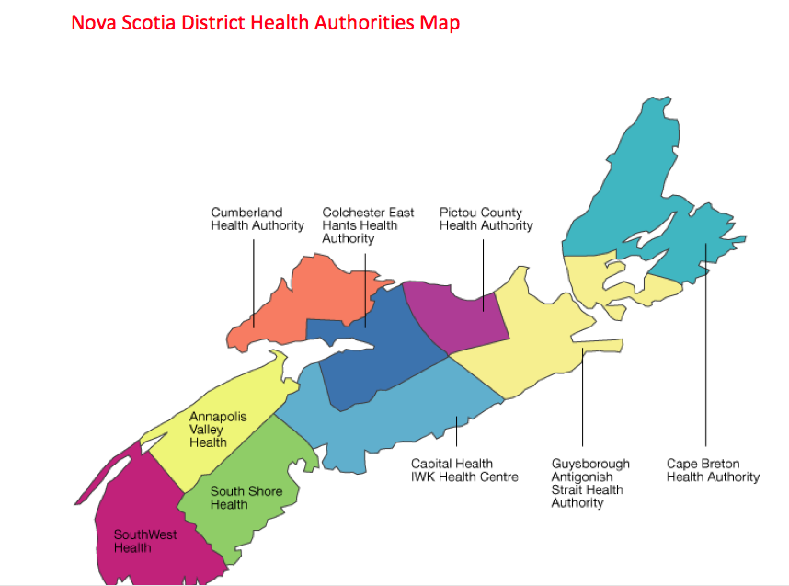
Notes:
Have them find this page and let the pharmacists know that book is organized by heath authority.

Slide 37
Helping Trees
Helping trees can assist you to find resources that are available in your local community.
If someone you know is experiencing a problem in any of the areas listed on the helping tree, just review the contents to find support.
Notes:
The resource includes something called helping trees, which are very helpful resources that provide much more than mental health resources. They help to identify key local resources for the things that people with mental health and addictions problems commonly need (e.g., housing, job support, legal advice, health questions, peer support, etc.).
The first helping tree, on the next page, is more general as it attempts to cover the needs of all Nova Scotians. There are more specific helping trees in the resources per health authority although some do not have a helping tree yet.

Slide 38
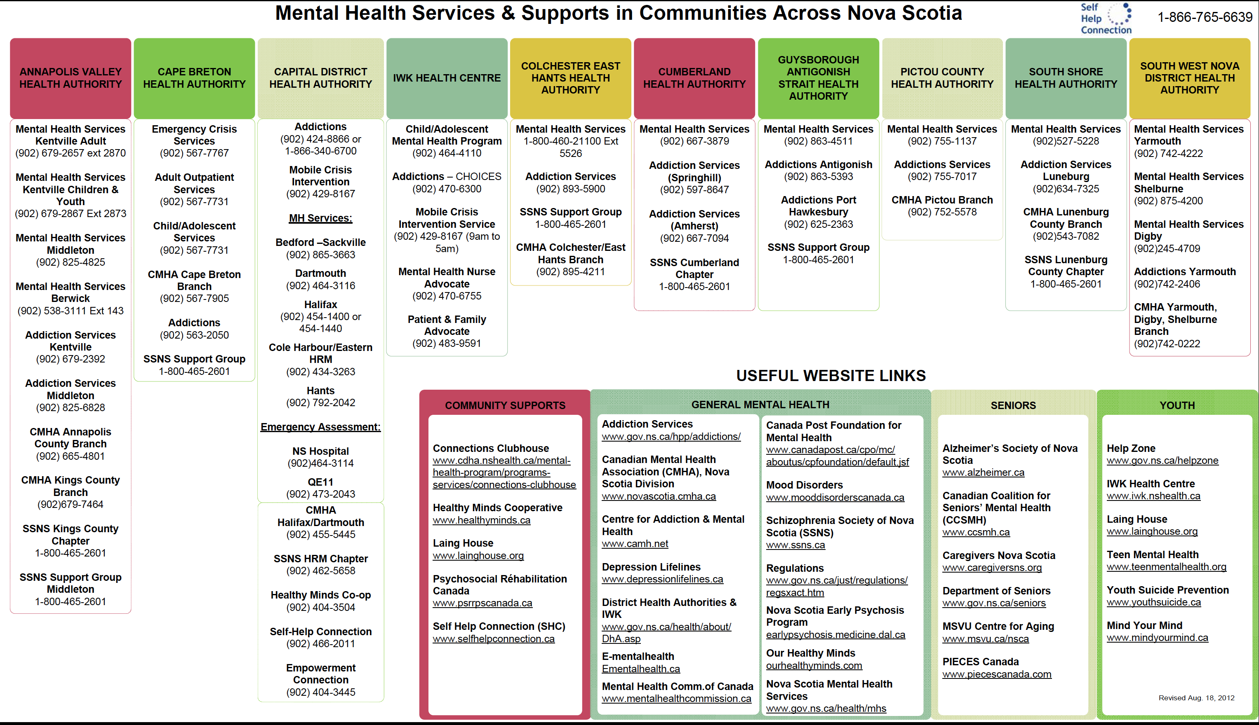
Notes:
You can offer to photocopy this for your patients (keeping an eye out for a quality print copy … as the text size is very small)

Slide 39
Notes:
An example is given of what you can find … but let pharmacists find the pages that pertain to their health authority region.

Slide 40
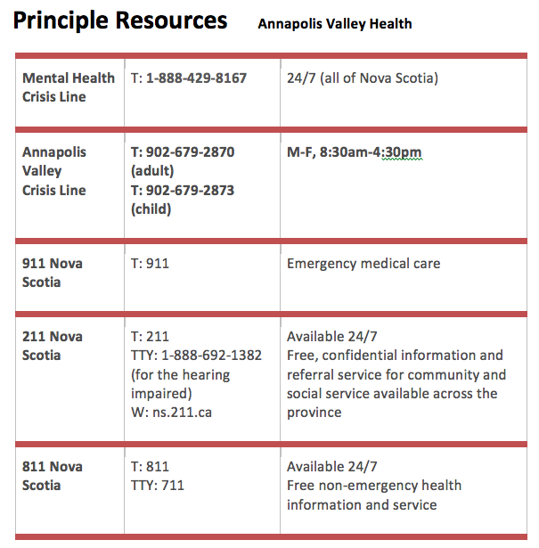
Notes:
All sections have this Principle Resources page. This may be a common go to page for pharmacists attempting to help people identify key local or province-wide urgent or emergent resources.
Pharmacists should be encouraged to review new resources including 211 Nova Scotia.

Slide 41
Where to Start:
Helping Tree
District Mental Health Services
Community Support Services
My Own Resources
Notes:
Each section has a page that let’s you add your own resources.
ALL PHARMACISTS should contact the More Than Meds team if they know of local resources not yet listed in the Navigator.

Slide 42
Notes:
A helping tree

Slide 43
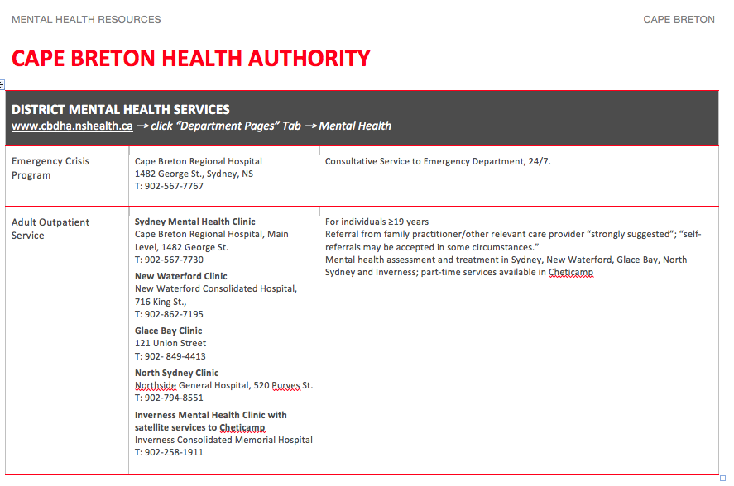
Notes:
Each section includes information about the formal government-based mental health and addictions services.

Slide 44
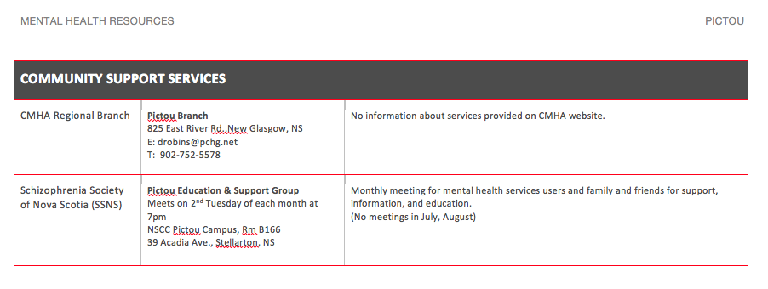
Notes:
Each section also includes COMMUNITY SUPPORT SERVICES, which often reflect the contact information for the not-for-profit mental health organizations.

Slide 45
Online Resources
Notes:
If you provided your trainees with a pre-training assignment that asked them to look online at various resources, for example different linked websites available on the More Than Meds resources webpage, the following slides would be where to discuss with them what they found.

Slide 46
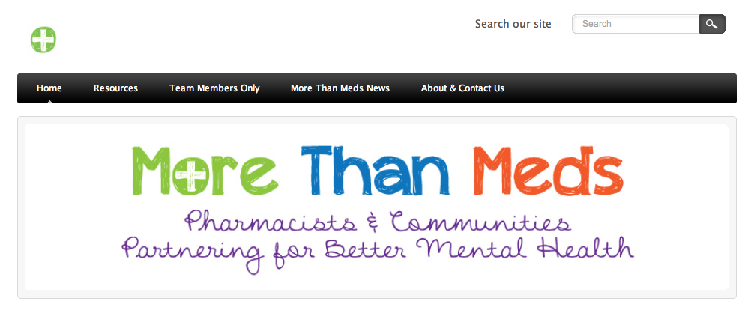
http://www.morethanmeds.com
Recommended resources
Notes:
The resources listed in the MTM website can only be useful if you are a) familiar with them, and b) use them to help your patients. The next few slides show a couple of websites but really what is needed is for the pharmacists to spend time getting to know the websites. As part of the training day, we had pharmacists and community members use the resources page in effort to help Dennis find help for his teenage daughter. For the websites to be really impactful we need the pharmacists to actively engage in learning about them.

Slide 47
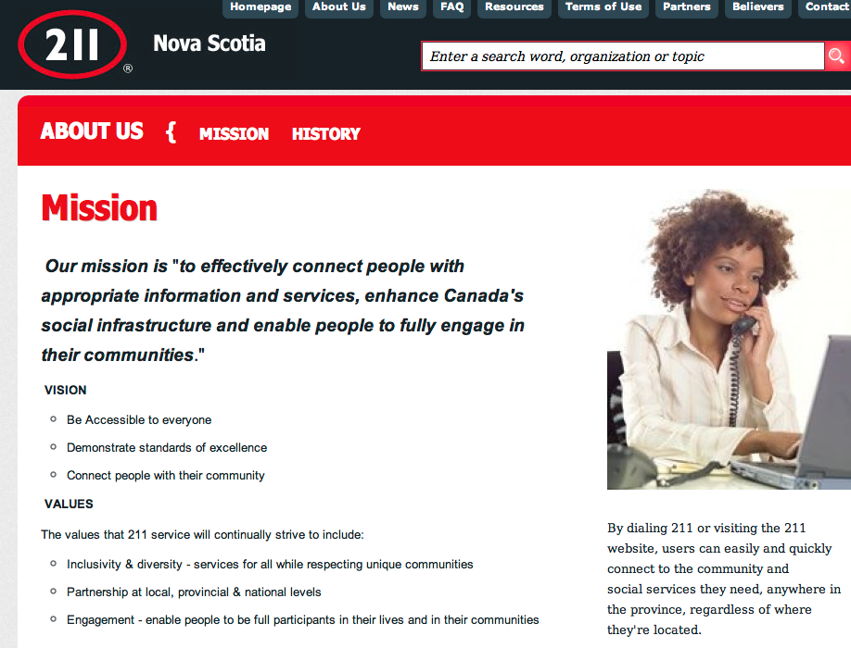
Notes:
211 Nova Scotia is a new and really helpful resource for all Nova Scotians. You can search the website or call the number – 211 – to get help in finding local community support, social and health information. Try it out!

Slide 48
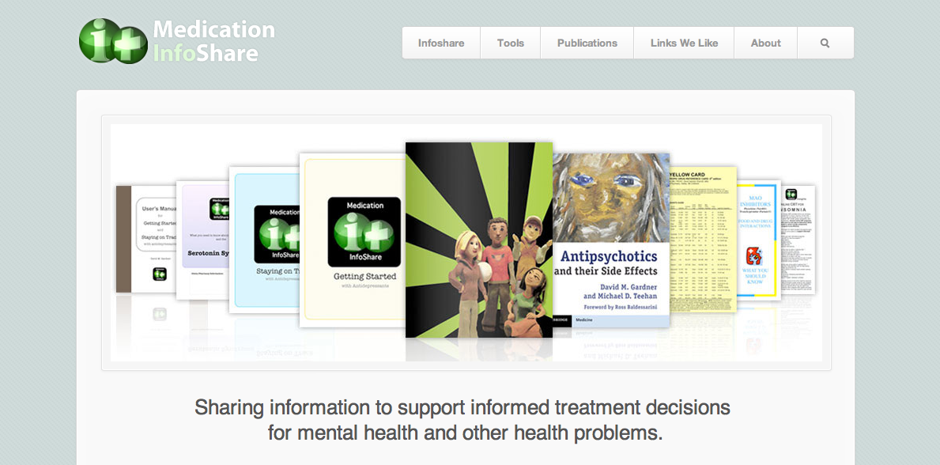
http://medicationinfoshare.com
Recommended resources
Notes:
This site has some tools and resources specifically helpful to pharmacists, physicians, and people living with mental health problems. Spend some time becoming familiar with them.

Slide 49
http://medicationinfoshare.com
Notes:
Ex:
Pharmacists are not just sources of medications, but also helpful advice for common problems such as insomnia.
CBT has been shown to be more effective than sedatives for people with long standing problems with insomnia. This pamphlet describes and compares the various online options, including the approximate costs.

Slide 50
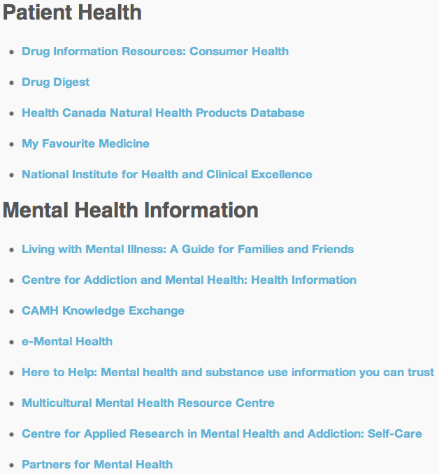
Links We Like
Notes:
Shown here are some of the listed websites that are recommended by medicationinfoshare (as of 05/2013).
Participants are encouraged to visit this website or the morethanmeds.com website for up-to-date recommended links.

Slide 51
Send us your suggestions
Websites
Tools you need
Navigator content
Notes:
Remind the new More Than Meds pharmacists that we welcome their suggestions for websites, needs, and local mental health and addictions resources.

Slide 52
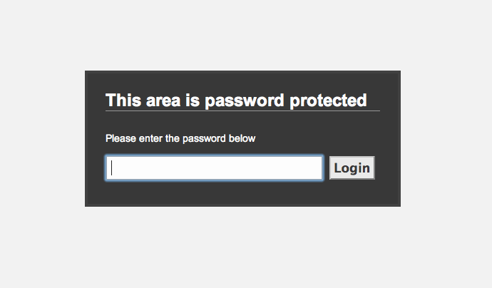
Health Professional Mental Health and Therapeutics Resources
mtm2013
Notes:
The password to our site is mtm2013.

Slide 53
What we’re going to discuss:
0:00 | XXXXX
0:00 | YYYYYYY

Slide 54
Case 1: Fran
Time: 8:00 pm on a Monday evening
Place: Community pharmacy in a town somewhere between Truro & Moncton
Setting: Pharmacy area is empty
Fran is seen at the OTC section
Notes:
For trainers background information, the full details of the case used in the original training day are provided below.
FRAN has more going on than Trouble Sleeping
SUICIDE AWARENESS/PREVENTION WORKSHOP
Key objectives:
To be able to detect, assess, support, and triage a person with suicidal ideation
To learn the components of a suicide assessment and the appropriate responses
To know which resources to use and when in the management of a person with suicidal intent.
INFORMATION FOR PHARMACIST (MARK Bosma)
Case:
Fran L. is a 45 year old female that comes into the pharmacy at 8:00 pm, a slow time of day for your pharmacy. She is just in the row in front of the pharmacy counter looking at the Advil Nighttime; she seems tired and restless. You step out of the dispensary to help her. She asks you, in a monotone voice and with little expression, “I have been having trouble sleeping is there anything you can give me to help?”
As the conversation proceeds and your concerns grow you invite Fran to sit down in a more private area so that your conversation won’t be interrupted.
INFORMATION FOR PATIENT
SP: “Fran”
Presenting compliant:
I have been having trouble sleeping is there anything you can give me to help?
General appearance:
45 years old tired, distressed woman
Appropriately dressed for the weather
Underweight
Has not showered in approx 3 days
Hair un-brushed
Body language:
Mildly restless and agitated
Mood/ affect:
Monotone
No or nearly no emotional expression
Abrupt initially when speaking to pharmacist
No interest in her future/ future plan like employment, etc.
Communications:
Communications change from being somewhat irritable to being emotional after the conversation changes from focusing on sleep to focusing on suicidal thinking. Talking about it is like a release of emotions. She becomes eager to tell the pharmacist, when in private, of her losses and of her thoughts of death and suicide.
Becomes increasingly comfortable opening up to pharmacist as he shows genuine interest and concern about her mental health.
Patient insight/ agenda:
*this information will not be given voluntarily
Is considering attempting suicide using alcohol and sleeping pills
Is talking to pharmacist to secretively get information to help make her plan
Is not convinced she really wants to take her own life.
Feels: depressed, like her family would be better off without her, has a hard time concentrating, feels helpless about what to do (doesn’t know how to fix how she is feeling), is hopeless about her future. When asked about her “plan”, she can reveal that she was looking to use sleeping pills and alcohol in overdose.
Medications current:
Ibuprofen as needed for headache, approx. 5 times a month
No over the counter medications
No natural health products or supplements
Has not tried anything for sleep yet except having 2-3 glasses of wine before bed.
Allergies:
No allergies
Doctor:
Has a family doctor
No specialists (never seen a psychiatrist)
History of present illness: [provide this information upon reasonable inquiry by the pharmacist]
Can’t get to sleep at night
Started about a year ago and has got worse in the past several weeks.
Was something that would go away after a few days of poor sleep, but has not relented for weeks now.
Gets an average of 4-5 hours a night, falling asleep at 4-5 am and waking up at 8-9 am.
Has daytime sedation and can’t really function, feels tired all the time.
House is a mess. Hardly any groceries. Doesn’t prepares meals.
Sleeps in a dark room, attempts to fall asleep starting at 11:30 pm normally.
Starts to think about losses, isolation, emptiness when trying to fall asleep.
Has recently lost weight without attempting to, just eating less, loss of appetite.
Feeling: Tired, restless, hard time concentrating, doesn’t get hungry, feeling down/ sad, lack of interest in future.
*Feels very guilty for not talking to her son and for her excessive use of alcohol
*Keeps having the thought that her family would be better off without her
*Has considered committing suicide (alcohol/ sleeping pills)
*Having second thoughts about her suicide plan: still wants to make amends with her son, who she loves very much
Past medical/psychiatric history:
Has experienced depressive episodes occasionally in her adult years.
No suicide attempts in the past.
Functions well between episodes.
During episodes has used alcohol to manage the pain of depression. An everyday occasion to drink until intoxicated after work.
Was unavailable to her family emotionally, was withdrawn, selfish, during her episodes. Relationships suffered.
Depressive episodes started in her later 20s.
Has taken various antidepressants. Agrees that some helped but doesn’t like the idea of them. In 2010 (see employment below), while on a leave of absence she was very depressed and drinking heavily. Eventually she agreed to cut down on her drinking and start an antidepressant on her family doctors advice. Her recovery was slow but eventually she was able to return to work.
Living situation/Relationships:
Living arrangements: Lives in Amherst, Nova Scotia, alone in the same house she lived in with her husband
Marital status: Divorced 3 years ago from husband, was not an amicable divorce and does not speak to him.
Children: Son, 23 years old, lives and works in Alberta, hasn’t spoken to his mother for months due to his disappointment in her drinking.
Parents: father died years ago (he was an alcoholic). Mother: lives in Amherst N.S. independently, age 70, good relationship (mother is a support)
Siblings: Her only local sibling, her older sister, died 7 years ago of breast cancer. They were close.
Social history:
Hobbies and recreation: Has two close friends in town who were very good to her when her husband left. She has withdrawn from them on several occasions and in turn them from her, straining the relationships. She stopped going to church several years ago after her sister died.
Employment: Lost her administrative position with the municipal office 6 months ago due to cutbacks. She had worked there since 2008 when the new mayor was elected. For 2 years she felt like the job was a gift from above. Her mood had never been better. However, in 2010 she experienced a severe depression and relapse of alcohol abuse. Her husband left her, moved to Moncton. She was given a leave of absence and she returned to work over a year later. Since losing her position recently, she has not been actively seeking employment, feeling no energy and no point.
Addictions history:
Has been drinking for 10 years since her relationship with her husband started to decline.
Drinks 3-4 drinks each day. Tries not to drink before 6 pm each day.
No recreational drug use
Acting instructions:
Information given with general questioning:
Presenting complaint: I have been having trouble sleeping is there anything you can give me to help?
Current medications: occasional ibuprofen for headaches (aka hangovers)
History of present illness: can’t sleep, late onset, short duration, constantly exhausted.
Past medical history: Will reveal current depressive symptoms and history of depression once speaking in private area.
Family medical history
Social history/relationships
General info on mood
Addictions history
Allergies
Doctor
Information given with specific questioning:
Patient insight/agenda: once guard has been let down, Fran feels quite emotional and relieved to tell someone about her psychic pain and wish to end things. She will reveal her thoughts of taking an overdose with sleeping pills and alcohol.
Feels very guilty for not talking to her son/ for drinking too much
Thinks that her family would be better off without her
But, is having second thoughts about her suicide plan (knows how much it would hurt her mother)
Phrases to use:
I don’t care…
It doesn’t matter…
I’ve given up on… (trying to talk to my son / finding a job / trying to stop drinking / keeping up with friends)
I have just been feeling so down lately
I just want to feel better and to be able to sleep
I just want to drift away …
I’m a disappointment to my son. He’s right about me. (being a waste of time of a mother)
When the pharmacist asks about sleep and what can help with sleep, inquire about sleeping pills (you want to know what is dangerous):
I just think so much when I try to go to sleep.
Which ones are the strongest?
How many is dangerous?
Should I not take these with alcohol?
What would happen if I took these with alcohol?
If asked these questions from suicide risk assessment or in general:
Are you thinking of suicide? yes
Do you know how you would do it? sleeping pills and rum
Do you know when? I don’t know, I just need to sleep and if I never came back that would be fine.
Have you ever attempted suicide? no
Risk Assessment:
SUICIDAL DESIRE
Suicidal Ideation: yes
Psychological pain: yes
Hopelessness: yes
Helplessness: yes
Perceived burden on others: no
Feeling trapped: no
Feeling intolerably alone: yes
SUICIDAL CAPABILITY
History of suicide attempts: none
Exposure to someone else’s death by suicide: no
HIstory of/current violence to others: no
Available means of killingself/other: searching for method
Currently intoxicated: not yet
Substance abuse: yes, alcohol
Mental illness: yes, depression
SUICIDAL INTENT
Attempt in progress: no
Preparatory behaviours: yes
Expressed intent to die: no (yes if prompted)
BUFFERS/CONNECTEDNESS
Immediate supports: no
Social supports: friends
Planning for the future: no
Engagement with helper: good relationship with mother
Ambivalence for living/dying: yes
Sense of purpose: no

Slide 56
Fran: Debrief
What are your thoughts about the case?
Do you have experience with people who are at risk of self harm or attempting suicide?
How did Mark do in detecting, assessing, supporting, triaging Fran?
Is this something that you and other pharmacists can do?

Slide 57
Suicide Assessment & Management Tools for Pharmacists

Slide 58
Suicide Assessment & Management Tools for Pharmacists
When you are concerned about someone being suicidal:
1. Assess current suicidal thinking
Is it passive or active?
Is there a plan?
Is there intent?
Is there means?
2. Assess the plan
Is it potentially lethal?
Is there access to the means?
Is there a place and time?
Have final arrangements been made?

Slide 59
Suicide Assessment & Management Tools for Pharmacists
When you are concerned about someone being suicidal:
3. Assess the risk factors
Precipitants/stressors (events in past 24 hours)
Suicide attempts/injurious behaviour
Concerning symptoms
Psychiatric dx
Substance abuse
4. Assess protective factors
Coping abilities, religious beliefs
Responsibilities (children)
Family/personal supports

Slide 60
Suicide Assessment & Management Tools for Pharmacists
When you are concerned about someone being suicidal:
5. Assess RISK LEVEL
HIGH: potential for lethal attempt, or persistent ideation with strong intent or rehearsal
MODERATE: suicidal intent with plan, but no intent or behaviour
LOW: thoughts of death, no plan, intent, or behaviour

Slide 61
Suicide Assessment & Management Tools for Pharmacists
When you are concerned about someone being suicidal:
6. INTERVENTION
LOW: “can we call a friend/health worker”, “let’s talk tomorrow”, …
MODERATE: “I’m very concerned about you. Can you stay with us until we contact …MD, Mental Health Crisis Line, Family, …
HIGH: Mobile mental health crisis, Mental health crisis line, 911

Slide 62
Case 2: Dennis
Time: 8:30 pm on a Friday evening
Place: Halifax Regional Municipality
Setting: Pharmacy area is quiet
Closing time: 9:00 pm
Patient: Dennis Carmichael approaches (well known)
Notes:
For trainers background information, the full details of the case used in the original training day are provided below.
DENNIS worries about Bailey’s mental state
Key objectives:
To be able to recognize and provide support for a care provider in distress
To promote the use of mental health resource tools in helping a person find local or provincial mental health services and supports.
To promote the use of high quality online resources to learn more about mental illnesses and their treatments
To promote the role of the pharmacist in helping people access mental health care and in being a part of the care from the start and in follow up
SP: “Dennis”
SCENARIO & INTERACTION:
You are the father of Bailey, your 17-year-old daughter, whom you are deeply concerned for. You visit your pharmacy at 8:30 in the evening (closes at 9 pm) to pick up your prescription medication for your obsessive compulsive disorder. The pharmacy is very quiet. It is only you and the pharmacist at the dispensary. The pharmacist asks how things are and you tell him about your concerns at home with Bailey. In your exchange with the pharmacist, you tell him the following:
The following will come out in a conversation (not all at once)
Sorry, I don’t mean to unload this on you but my wife and I are at our wits end.
I’m worried about my daughter, Bailey. She’s been acting kind of ‘bizarre’ over the last 2-3 months, and Kellie (wife) and I don’t know what to do.
Bailey has been really withdrawn, and has been accusing her 14-year-old brother of stealing her stuff, like clothes and school work. He swears that he hasn’t been, and we believe him.
Her room is a mess.
She spends a lot of time alone, and it’s hard to get her to leave her room when she’s not at school.
Kellie has been asking her why she hasn’t been showering or taking care of herself, but they just end up arguing. She used to really take care of herself. She was social. She’d keep her room tidy. All of that has changed. It is very bizarre now.
She’s been skipping school.
Her grades have been dropping.
I think she has been using pot. I’ve smelled it on her but she denies it saying there were other kids at school smoking up when she was leaving.
She hasn’t been hanging around her old friends. That’s been for a while now. I don’t really know who she is hanging out with anymore.
She’s been staying up way later than she usually does. Some nights, I wonder if she sleeps at all!
I’ve gotten her to go to the doctor’s office, twice, but she minimizes everything when we are there. He doesn’t seem to get how bad it is.
I just don’t know what to do – my wife and I are at our wits end with worry, and we’re trying to sort out what to do.”
PHARMACIST: Sample questions by Pharmacist to Dennis:
Have you spoken with your family doctor?
What about school? Are they reporting anything to you and Kellie about Bailey’s behaviour?
Is she socializing with friends? Are these her old friends or new friends?
How long has this been going on for?
What do you think might be the cause of this?
So, you would like to get a mental health specialist involved?
Are you concerned about drug use or anything else specifically? Bullying? Boyfriends?
Is she hearing voices?
Does she sound down or depressed?
Are you concerned that she might hurt herself?
I can try to help, but is there anything specific you are looking for from me?
BACKGROUND INFORMATION:
Family Relationships and Living Situation: You are a 48-year-old man. You have been married for 25 years (Kellie) and have a 17 yr old daughter (Bailey) and 14 yr old son (Jack). You live in Cole Harbour, NS. You both work full time for the same insurance company. You leave for work before the children leave for school, which they get to by walking.
SOCIAL HISTORY
Occupation: Bailey was working part-time at a local Dairy Queen. She quit a while ago stating that the manager was not giving her many shifts and only the really bad ones. She wouldn’t talk more about it.
Hobbies and Recreation: Over a few months Bailey stopped hanging out with her usual school friends. She mentioned hanging out with some other people, names you were not familiar with and you never met them. She doesn’t have her license and says she doesn’t need to drive.
MEDICAL HISTORY:
You (Dennis): You have a history of obsessive compulsive disorder (OCD). The symptoms are very well managed with Anafranil® (an antidepressant used in the treatment of OCD.
You take 200 mg a day and have been doing great for the last 5 years. Your pharmacist Glenn has been very helpful to you over the years with managing some of the side effects of clomipramine (constipation, sedation, dizziness, dry mouth). Over time these side effects have lessened such that they don’t really bother you any more.
Bailey: had bad acne in the past, but she took a really strong acne medication 2 years ago (Accutane®) that really cleared things up. She currently takes acne cream for her face and birth control pills for acne management and to reduce menstrual cramps.
Kellie (your wife): no mental or physical health issues. Is close to Bailey and is extremely worried about her. They used to do lots together. Bailey has now withdrawn from her and has been very irritable whenever Kellie has suggested going out together (groceries, mall, movie, etc. )
Uncle Ian: Your Dad had an older brother Ian, who would be Bailey’s great uncle. Your family thinks that he had a serious mental illness, maybe bipolar disorder. He was very eccentric. In his young twenties he moved to Toronto and died shortly thereafter. Your dad never really talks about it. You think your Dad (Bailey’s grandfather) lives with Depression.
MOOD, AFFECT, AND DEMEANOR:
Bailey has been keeping to herself more, being very withdrawn, and not speaking much at all. She accuses her 14-year-old brother of stealing her stuff (clothes, school stuff) and moving her phone. She is usually very tired, and doesn’t want to do things with her family that used to be fun for her. She stays in her room a lot of the time. She often stays up very late and sleeps in, missing school. Kellie has stayed home a few days to try to get her to school on time, but this causes a lot of grief.
Bailey has always been a B⁺/A⁻ student, but her last report card was mostly C/C⁺. You’re also concerned, because you’ve been getting calls saying she’s skipping classes. She’s skipped 2 classes last week.
Appearance:
You’ve noticed she’s drastically changed the way she dresses lately. She used to be extremely picky about always wearing clean, ironed clothing, and now doesn’t do laundry despite a clear need to. She doesn’t straighten her hair as she used to, wears her old, tattered, shoes from 2 years ago, and doesn’t seem to be showering often.
You’ve noticed the smell of pot smoke coming from her clothing, and you suspect she may be smoking marijuana…but you’re not sure.
PARENT RESPONSES TO PHARMACIST
Information offered spontaneously:
Medical history for both you, and your daughter
Age of daughter
Withdrawn behavior
Information given with general questioning:
Family/Living history
Social history
Mood, affect and demeanor
Appearance
Body Language (eye contact, mannerisms, etc.):
You are clearly worried about Bailey. While polite and not meaning to dominate the pharmacists time, you are hoping he can give you some guidance. You listen keenly hoping he will give you something that his helpful to you. You show signs of worry throughout the conversation: sigh, look at the ground…etc.
Mood/Affect
After you vent, be open to the suggestions the pharmacist makes. Be open and responsive: you are open to any suggestions on how to deal with this, as you’ve not dealt with this before.
Communication:
You value the privacy of this matter very deeply. If the pharmacist suggests a private room, take them up on the offer and be more open/talkative for it.
What you really want/need is support and guidance, be it from the pharmacist or from a resource. You’ve got to go home and try to help your child: can you do that with what they’ve said?
Be sure to ask specifics on what to do.

Slide 63
Case 2: Dennis

Slide 65
Let’s Help Glenn Help Dennis
Work as a pair
Using you print and online tools, what resources can you guide Dennis to?
How will you talk to him about this?
You have 10 min.

Slide 66
Dennis: Debrief
What are your thoughts about the case?
Do you have experience with needing to find mental health resources for your patients?
How did Glenn do in listening, asking, supporting, and advocating for Dennis?
Is this something that you and other pharmacists can do?

Slide 67
What we’re going to discuss:
0:00 | XXXXX
0:00 | YYYYYYY

Slide 68
The More Than Meds Training Model
Train-the-Trainers:
6 pairs (pharmacist+community member)
2. Paired trainers’ pharmacist training:
≥5 community pharmacists per pair
Notes:
Use this and the next few slides to show the pharmacists how this program all fits together so they get an understanding of their contribution.

Slide 69
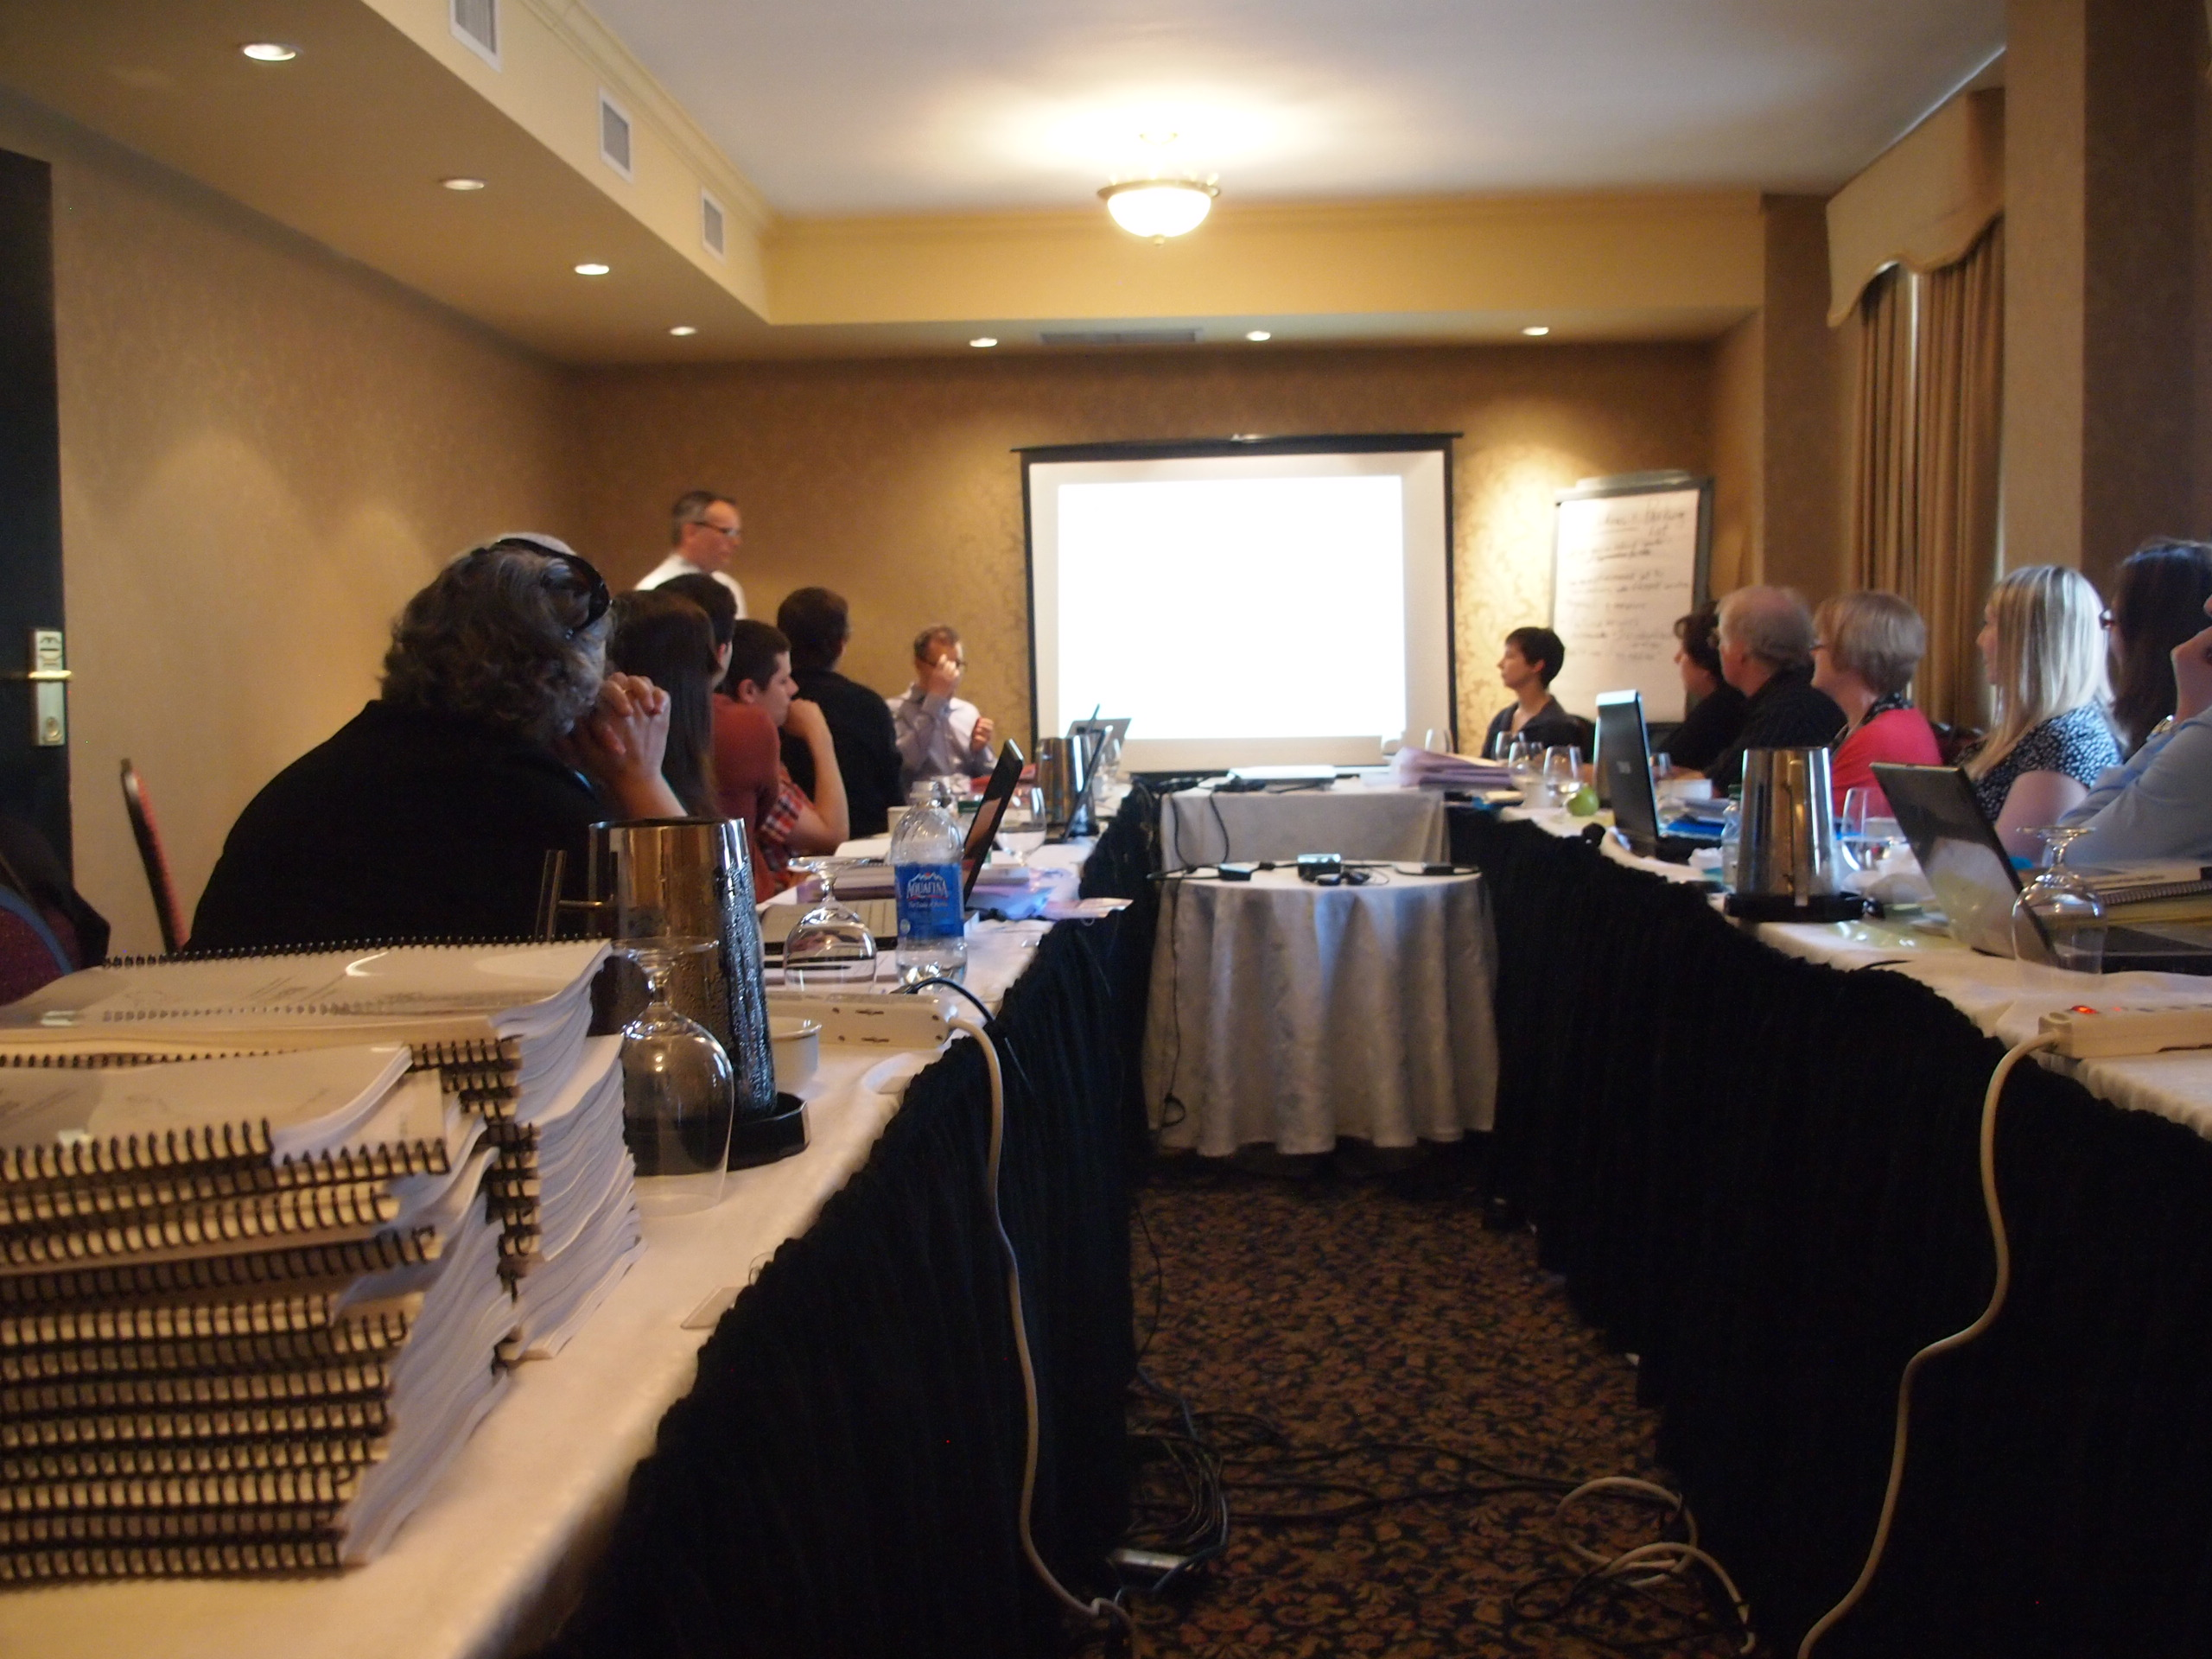
Notes:
Here we are at the training day on May 17.

Slide 70
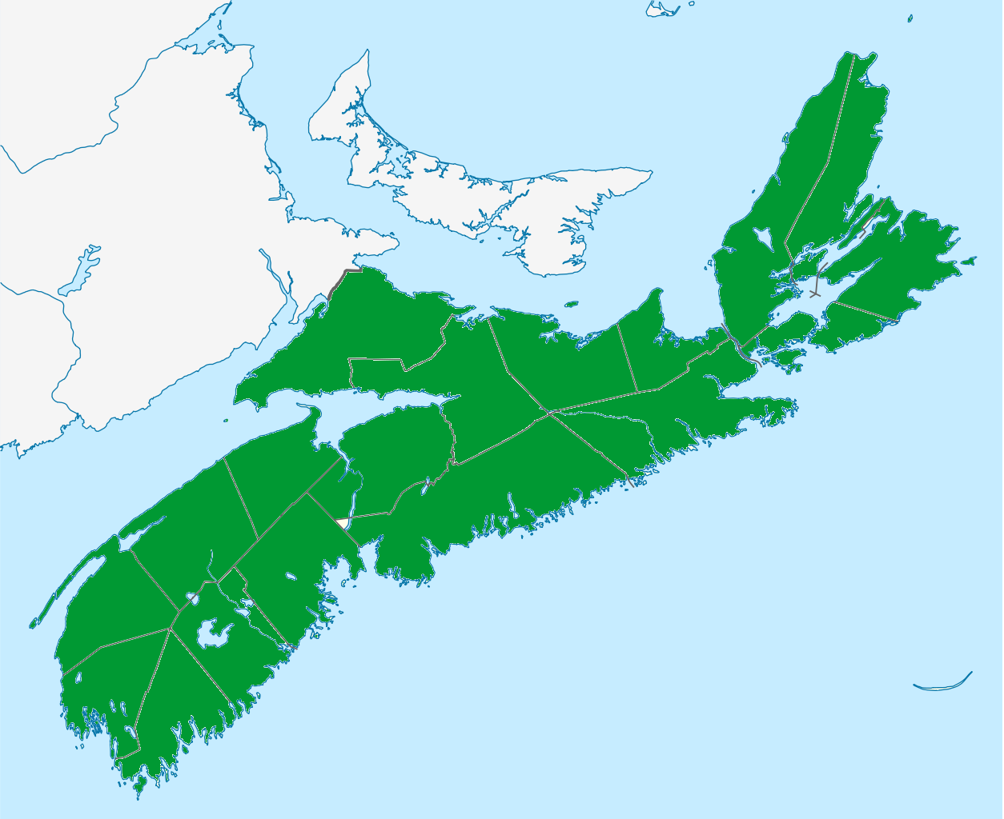
MORE THAN MEDS
Train-the-trainers Training Day
May 17, 2013
6 pharmacist-community member pairs
Pair sharing & team building
Resources
Tool kits
Pharmacist (psychiatrist)–actor role plays
Tasks and planning
Notes:
Use the next 3 slides to show how the training will lead to a widely disseminated and impactful program of pharmacists doing 1 or more community outreach sessions in addition to building their confidence and competence while at work.
These slides are animated. Practice using them before your presentaiton as some of the animations are automatic and timed and others require a click for the action to start.

Slide 71
Community member
Community pharmacst
Notes:
Pharmacist-community member pairs return to their regions after the training and identify 5 pharmacists for training. This pair and the 5 trained pharmacist commit to providing some sort of outreach support and/or education session. This is done by connect with local mental health support groups and working with them to organize an education session or working with them to help them achieve their organization’s objectives. The idea here is that a pharmacist with personal experiences and connections with local mental health groups will be better at identifying with people’s needs and in helping people find resources and help. If making this kind of connection is not practical, the the pharmacist is encouraged to develop their own outreach event – we have referred to these as “How’s it going?” sessions. We have prepared posters for these events to help with advertising and recruitment. More on this later.
As you can see, as the pharmacists provide these community-based sessions, the reach of the More Than Meds program, to people living with mental illness across Nova Scotia, will be quick and extensive.

Slide 72
Notes:
By training 36 or more pharmacists (6 pharmacists on May 17th plus the 5 that they train each is 36), we are hoping to have 36 pharmacists meaningfully engaged locally with their mental health communities, each offering some sort of outreach or educational service.

Slide 73
The Deliverables & the Spirit
Deliverables
Spirit
≥1 community education/outreach session
Build capacity through community pharmacist – mental health community partnerships
Capacity: the ability of the formal health care system, NGOs, support groups, families, and other informal community supports and actions to better care for and help people living with mental illnesses and addictions
Notes:
The idea here is that a pharmacist with personal experiences and connections with local mental health groups will be better at identifying with people’s needs and in helping people find resources and help.

Slide 74
≥1 community education/outreach session
1. Discover: What mental health support groups and education programs exist in your region?
2. Inquire: Can I offer a session on …
Ex. Heart health (a session for a mental health community group)
Ex. Medications & Mental Health
Ex. Q&A: Medications for Anxiety & Depression
Ex. Can’t sleep? There’s more than meds (eg partner with local psychologist)
Ex. How over the counter medications interact with prescription medications.
or
3. Invent: How’s it going?
Create your own session (unaffiliated)
When: Before December 15, 2013
Who: You plus others (ideally) or you alone
Where: Your ideas
Contact david.gardner@dal.ca or andrea.murphy@dal.ca for ideas and support
Notes:
All pharmacists should consider finding one or more partners for jointly providing their outreach/education session. This is akin to the training of today in which the effectiveness of the training is greatly enhanced when other expertise and perspectives are considered.
[The training of the five pharmacist should be shared by the paired trainers. Other people can be invited to contribute to the training session, eg. Social worker, etc.]
You do not need to run a session on psychiatric medications or even on mental health issues. For example, you can connect with a mental health support group in your local area and offer to run a session on CV & diabetes issues, smoking cessation, etc. You could inquire about what people want to learn about and try to meet their interests and needs. If you run a session on psychotropics and mental health you can narrow it to a defined topic (e.g., The challenges and considerations of starting, combining, switching, and stopping mental health medications; Mental health medications and weight management; Managing the side effects of antidepressants and antipsychotics; Pot, Alcohol, other substances and Mental Health, etc.).

Slide 75
Community Pharmacist Mental Health Education Session Advertise and promote your session
Options:
Use your ideas
Work with your partners
Use pre-made poster templates (www.morethanmeds.com “team members only” page)
Put up poster in your community
Call people you think would want to participate
Place one or more free ads on Kijiji
Advertise in local newspapers and bulletins
Notes:
All outreach/educational sessions need to be evaluated.
We will send you the evaluation form but you need to give us advanced notice. The forms are on the website for you to print and copy also.
If you are creating your own event, this is the poster template that you can use. [give out copies at your training session]

Slide 76
Community Pharmacist Mental Health Education Session Outreach/educational event practicalities
Contact the project coordinator well in advance of your session
Go to http://www.morethanmeds.com/team-members-only.html. Download the forms you need.
Review the checklist >1 week in advance
Prepare your materials including evaluation forms
Provide your session; collect evaluations at the end
After the session, submit your session’s report along with the completed evaluation forms
We can send you a package (if you give us enough time)
Ted.naylor5@gmail.com
Optional:
Photo of your session (of you) for www.morethanmeds.com
Notes:
All outreach/educational sessions need to be evaluated.
We will send you the evaluation form but you need to give us advanced notice. The forms are on the website for you to print and copy also.
If you are creating your own event, this is the poster template that you can use. [give out copies at your training session]

Slide 77
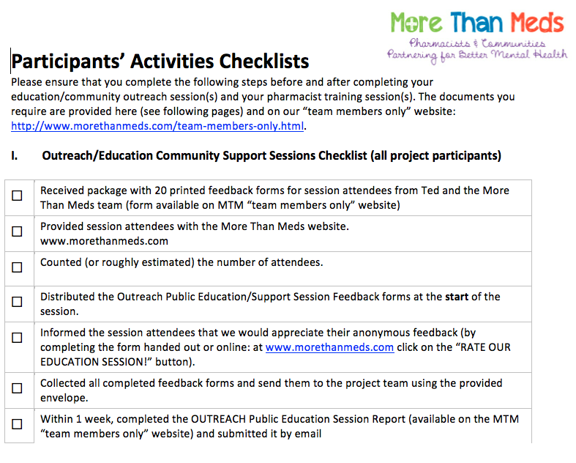
This is the checklist you will find on the website

Slide 78
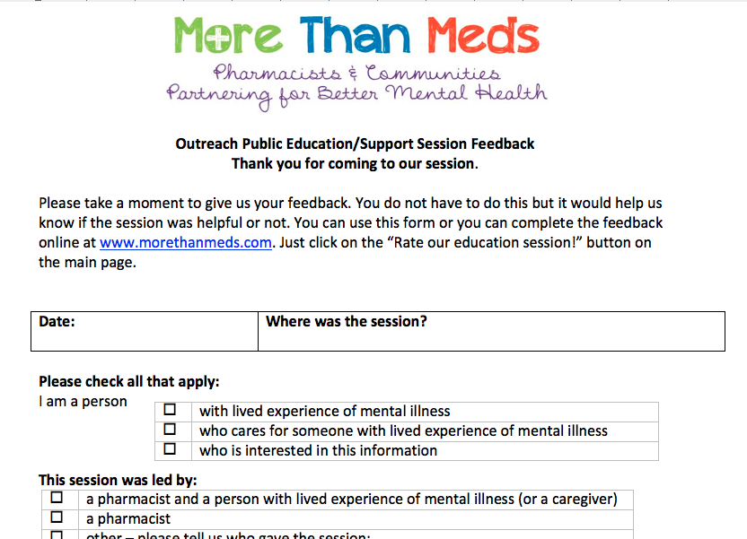
Outreach/Educational Session Session Feedback
coordinate in advance with us Ted.naylor5@gmail.com
Or print and make copies of your own from the MTM website “members only” page
Notes:
Session feedback is important for us to track if people like the sessions. Contact us in advance of the session and we will make sure the trainees have enough copies.

Slide 79
Submit your session report within 1 week

Slide 80
Your are one of our MTM Network Trainees!! We are here to support YOU.

Slide 81
Trainees Key Discussion Points
1. Trainees are to contact MTM team for support & materials
2. Use the www.morethanmeds.com site as a resource

Slide 82
Thank you for participating in the more than meds project

